Slide 1

VB Script

Slide 2

Outline
VBScript & the Web
VBScript Basics
Variables, subtypes & Constants
Arrays
VBScript Operators
VBScript Procedures
Program Control & Structure
Strings & Numbers
Message & Input Boxes
Dates & Times
The Document Object Model
Event Handlers

Slide 3
Objectives
In this tutorial, you will learn:
  To become familiar with the VBScript language.
  To use VBScript keywords, operators and functions to write client-side scripts.
  To be able to write Sub and Function procedures.
  To use VBScript arrays and regular expressions.
  To be able to write VBScript abstract data types called Classes.
  To be able to create objects from Classes.
  To be able to write Property Let, Property Get and Property Set procedures.

Slide 4
Introduction
VBScript
  Subset of Microsoft Visual Basic
  Specific to Internet Explorer
  JavaScript has replaced VBScript as standard
  Most commonly used alongside ASP
    Active Server Pages

Slide 5
Operators
Types of operators
  Arithmetic
    Most are similar to JavaScript’s
  Logical
  Concatenation
  Comparison
  Relational
VBScript is case-insensitive

Slide 6
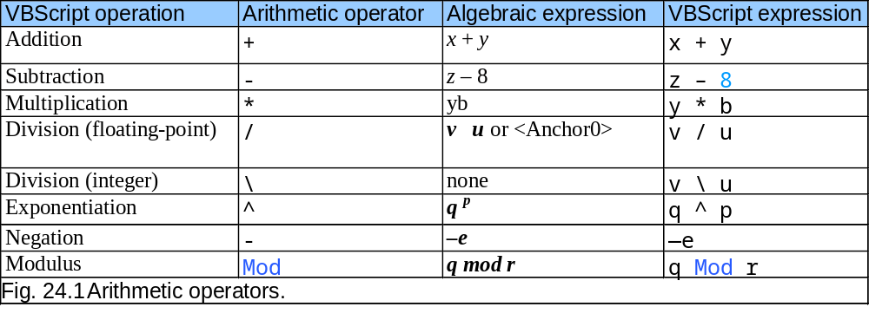
Operators

Slide 7
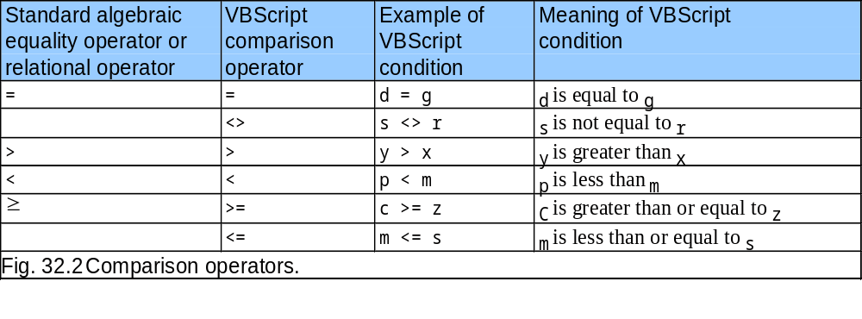
Operators
≠
≤

Slide 8
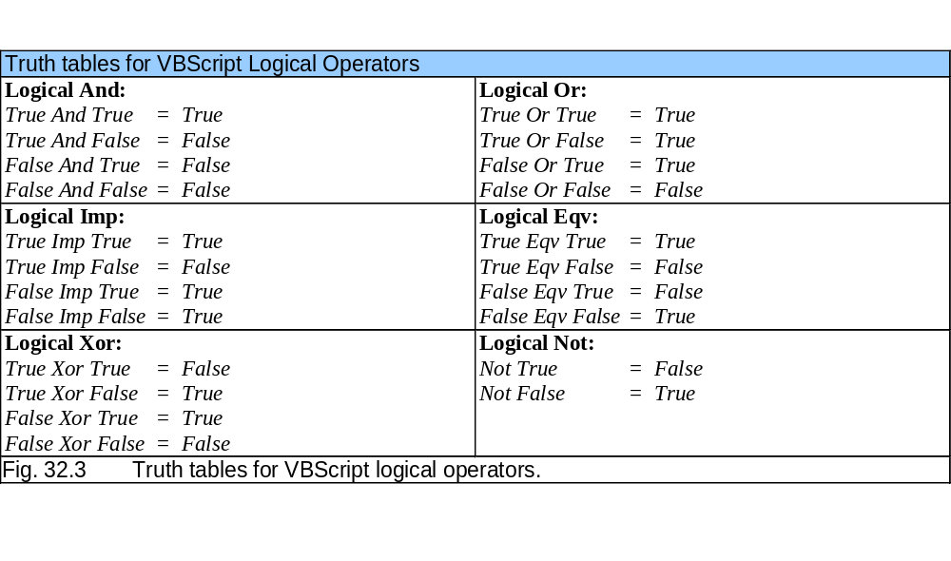
Operators

Slide 9
Operators
String concatenation
  & and + operators both perform concatenation
  Always use & operator
    + will attempt addition if both operands are not strings

Slide 10
Data Types and Control Structures
Variant type
  Only data type
  Many subtypes which mimic standard data types
  VBScript treats each variable as the type of data it currently contains
  Not necessary to declare a data type
Variable names
  Cannot be keywords
  Must start with letter
  Option Explicit
    Forces variables to be declared before use

Slide 11
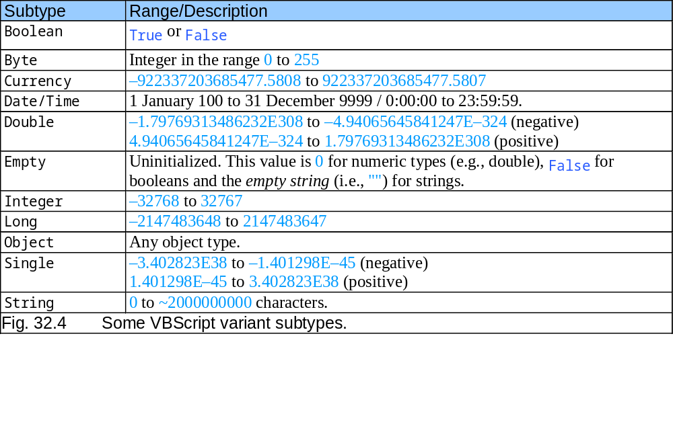
Data Types and Control Structures

Slide 12
Data Types and Control Structures
Control structures
  Begin and end with keywords
    Not braces, as in JavaScript
  Statements end when line ends
    No semicolons
  Parentheses optional

Slide 13
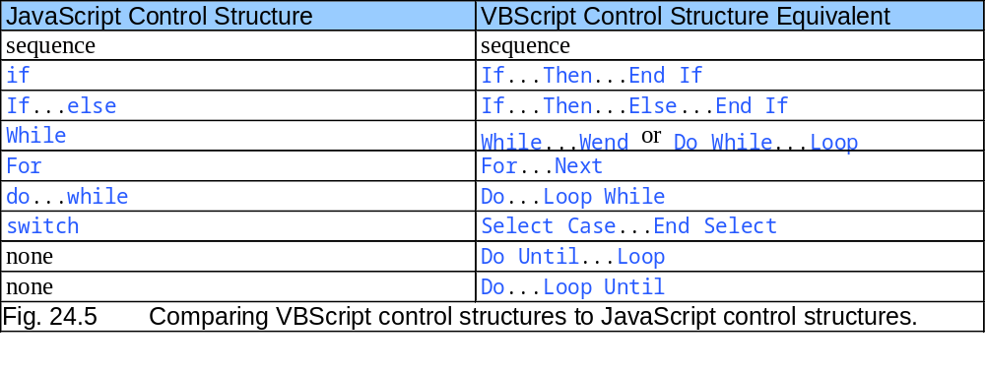
Data Types and Control Structures

Slide 14
Data Types and Control Structures
Multiple-selection
  Elseif keyword
    Replaces if…else if…else statement of JavaScript
  Select Case statement
    Replaces switch in JavaScript
    No break; statement
    Case Else replaces default case

Slide 15
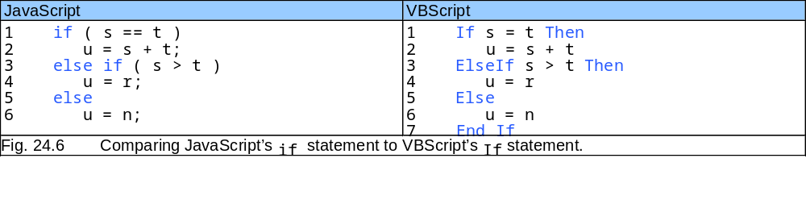
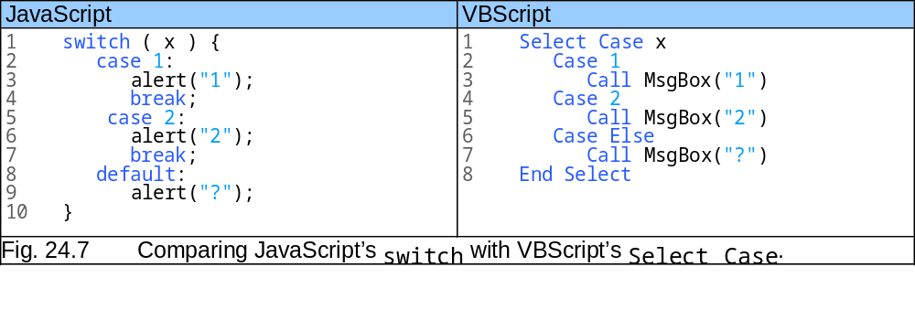
Data Types and Control Structures

Slide 16
Data Types and Control Structures
Looping
  While…Wend and Do While…Loop
    Analogous to JavaScript’s while statement
  Do…Loop While
    Analogous to JavaScript’s do…while statement
  Do…Until Loop and Do…Loop Until
    No direct equivalent in JavaScript
    Repeat until loop-continuation condition is true
  For
    Condition cannot be modified mid-loop
    Optional Step keyword
  Exit Do and Exit For
    Break out of loops

Slide 17
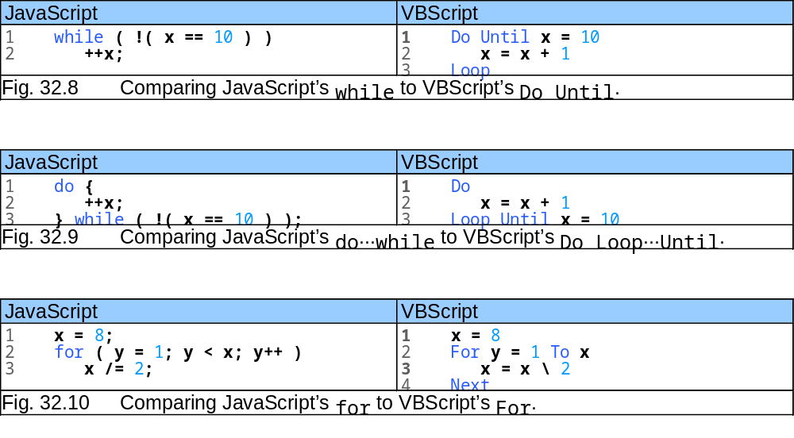
Data Types and Control Structures

Slide 18
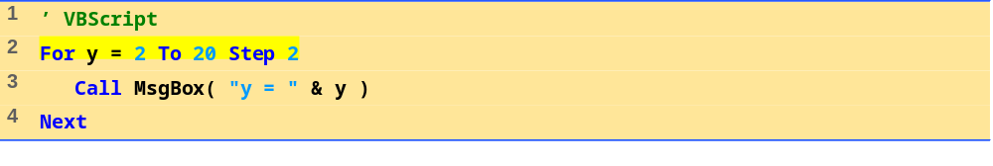
For Loop Sample
For repetition statement with keyword Step

Slide 19
VBScript Functions
Calling functions
  Keyword Call
  Line continuation character
    _ (underscore)
Type functions
  VBScript provides set of built-in functions
  Many deal with determining subtype of Variant variable

Slide 20
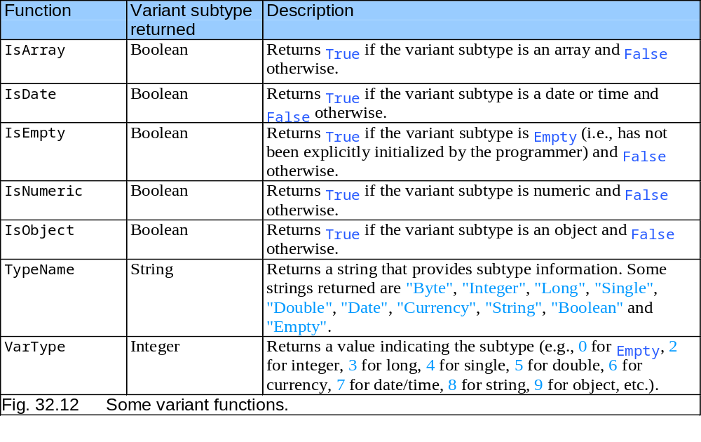
VBScript Functions

Slide 21
VBScript Functions
Math functions
  VBScript provides many functions for common operations
    Exponential
    Logarithmic
    Square root
    Rounding
    Absolute value
    Trigonometry
    Random number generation

Slide 22
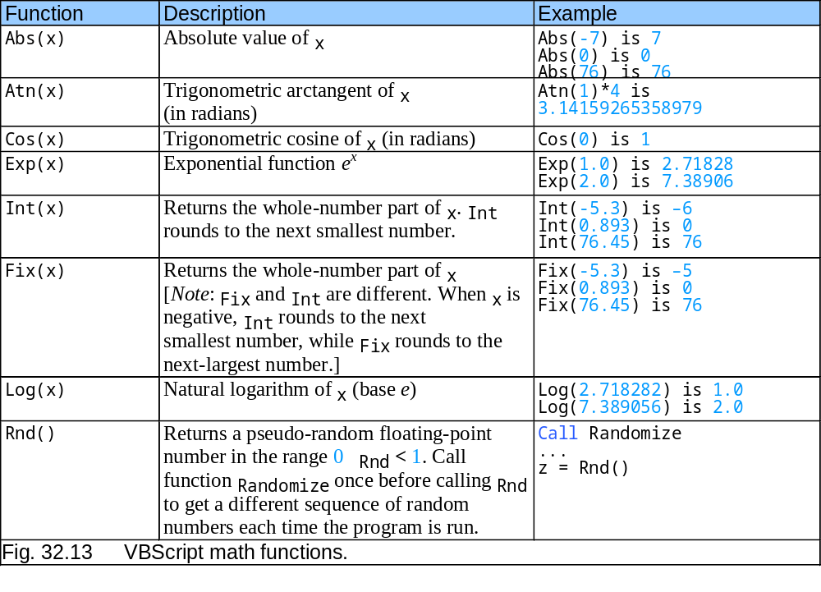
VBScript Functions
≤

Slide 23
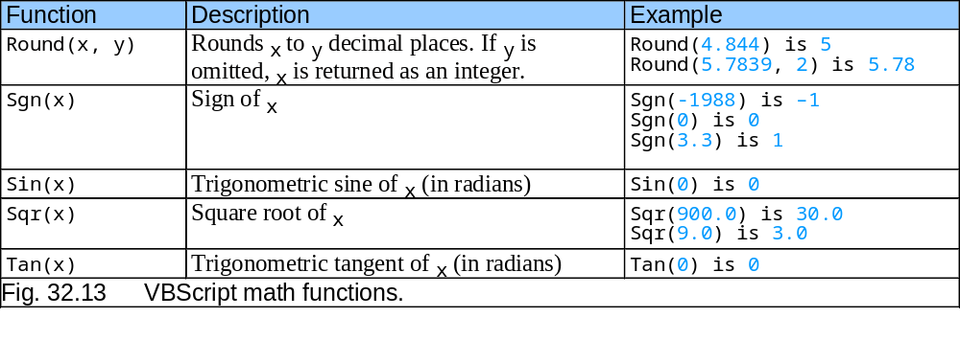
VBScript Functions

Slide 24
VBScript Functions
Formatting functions
  Currency
  Dates and times
  Numbers
  Percentages

Slide 25
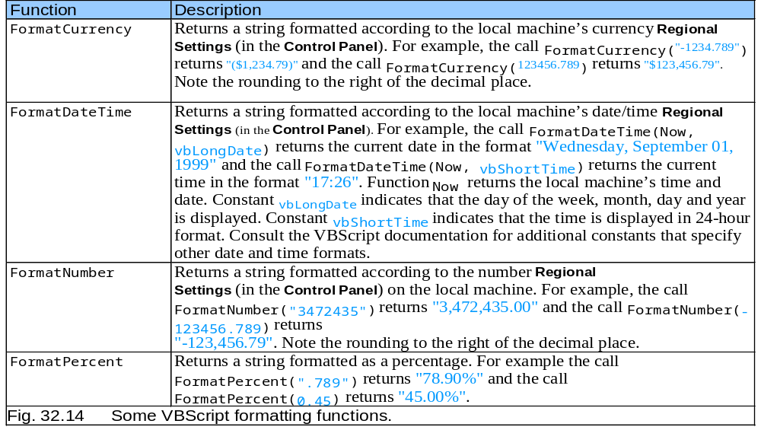
VBScript Functions

Slide 26
VBScript Functions
Informational functions
  ScriptEngine
  ScriptEngineBuildVersion
  ScriptEngineMajorVersion
  ScriptEngineMinorVersion
  Example:
  Returns:
  "VBScript, 5207, 5, 5"
ScriptEngine() & ", " & ScriptEngineBuildVersion() & ", " _
& ScriptEngineMajorVersion() & ", " & _
ScriptEngineMinorVersion()

Slide 27
VBScript Functions
User interaction
  InputBox
    Displays dialog that accepts input
  intValue = InputBox( "Enter an integer", "Input Box", , 1000, 1000 )
  MsgBox
    Displays message dialog
    Customizable buttons and icon
  Call MsgBox( "VBScript is fun!", , "Results" )

Slide 28
VBScript Example Programs
Example using addition
  <script> tag type attribute
    text/vbscript
  Enclose code in XHTML comments
    Keep incompatible browsers from displaying as test
  OnClick
  Local variables
    Only exist inside procedure where declared
  Event procedures
  CInt
  Constants

Slide 29
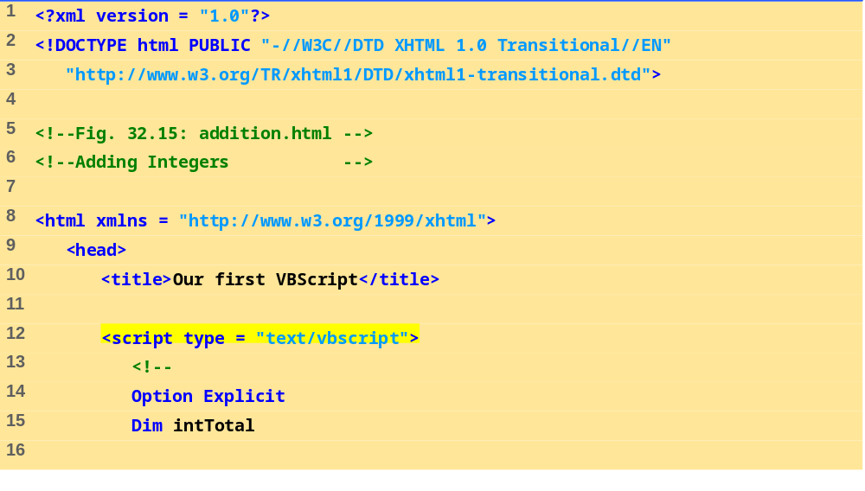
addition.html
Set type to VBScript.
Option Explicit statement.

Slide 30
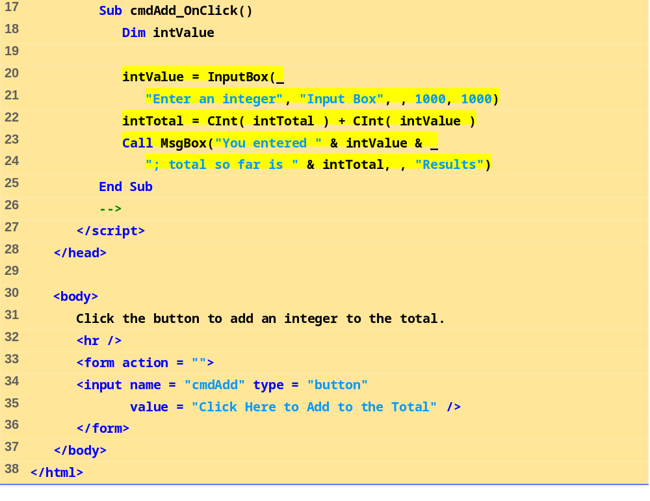
addition.html
Define procedure OnClick for the cmdAdd button.
Use CInt to convert input values from string subtype to integer subtype.

Slide 31
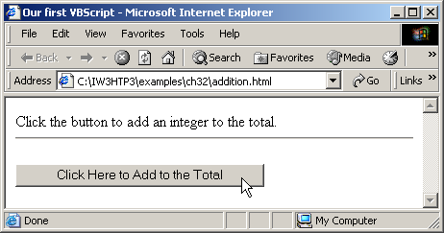
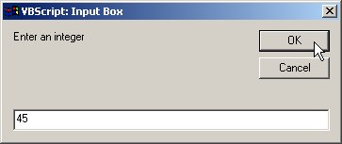
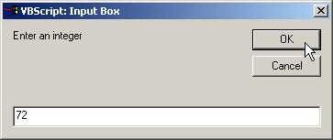
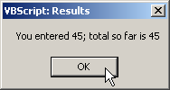
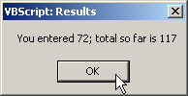
VBScript Example Programs

Slide 32
VBScript Example Programs
Example of redirection
  Send browser to a different URL
    Location property
  for attribute
  OnChange event
  Accessing properties
    SiteSelector.value

Slide 33
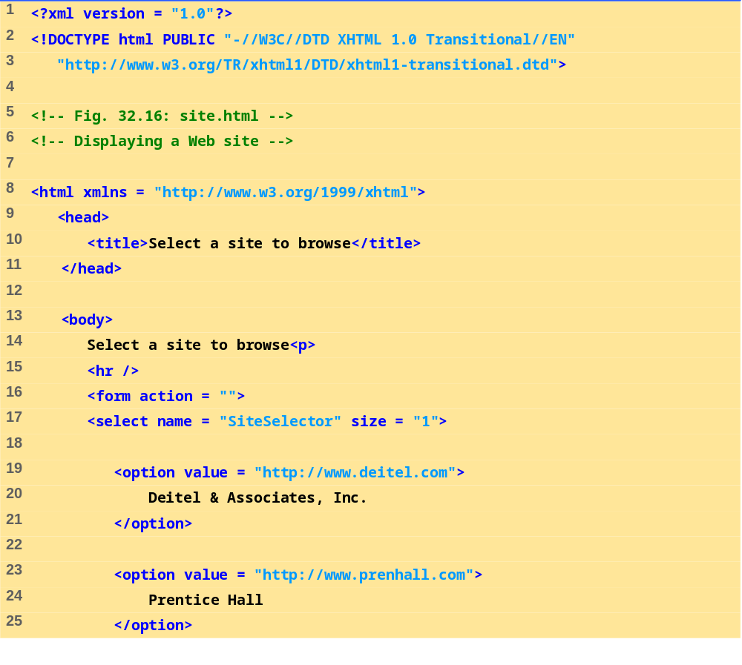
site.html
Create form with select component.

Slide 34
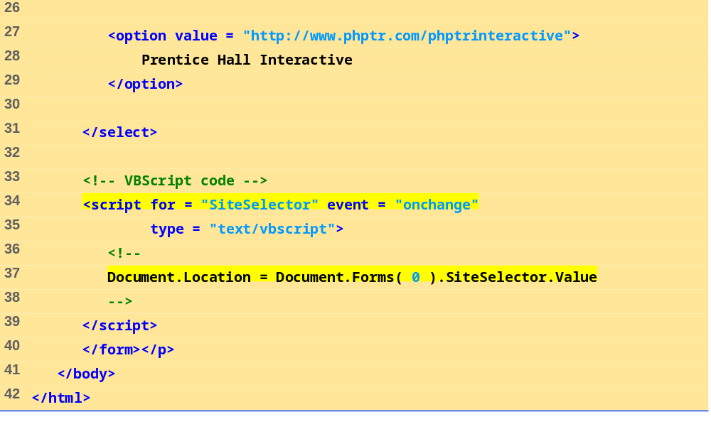
site.html
The event attribute indicates the
event to which the script responds (OnChange).
The <script> tag’s for attribute indicates the XHTML component on which the script operates (SiteSelector).
Script response to user’s selecting an option in the menu

Slide 35
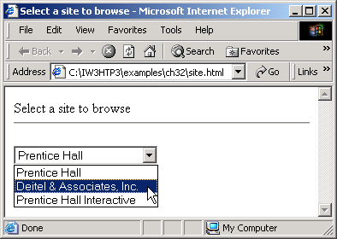
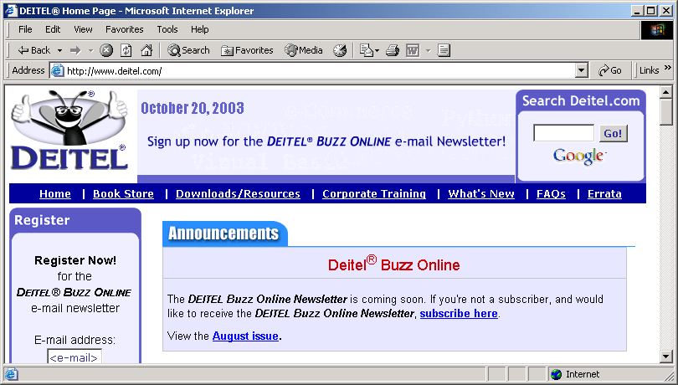
VBScript Example Programs

Slide 36
VBScript Example Programs
Comments
  ‘ and keyword Rem
  ‘ character is preferred style
Programmer-defined procedures
  Keywords Function, Sub, End Sub and End Function
  Returning values
    Variable with same name as procedure
  Place in page head section so all scripts can access them
  Keywords Exit Function and Exit Sub

Slide 37
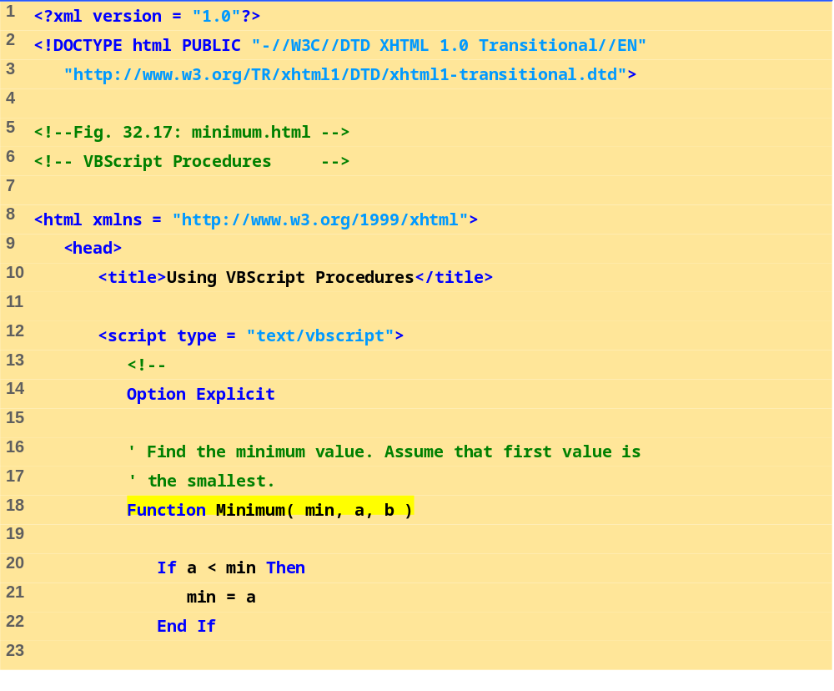
minimum.html
Define procedure Minimum.

Slide 38
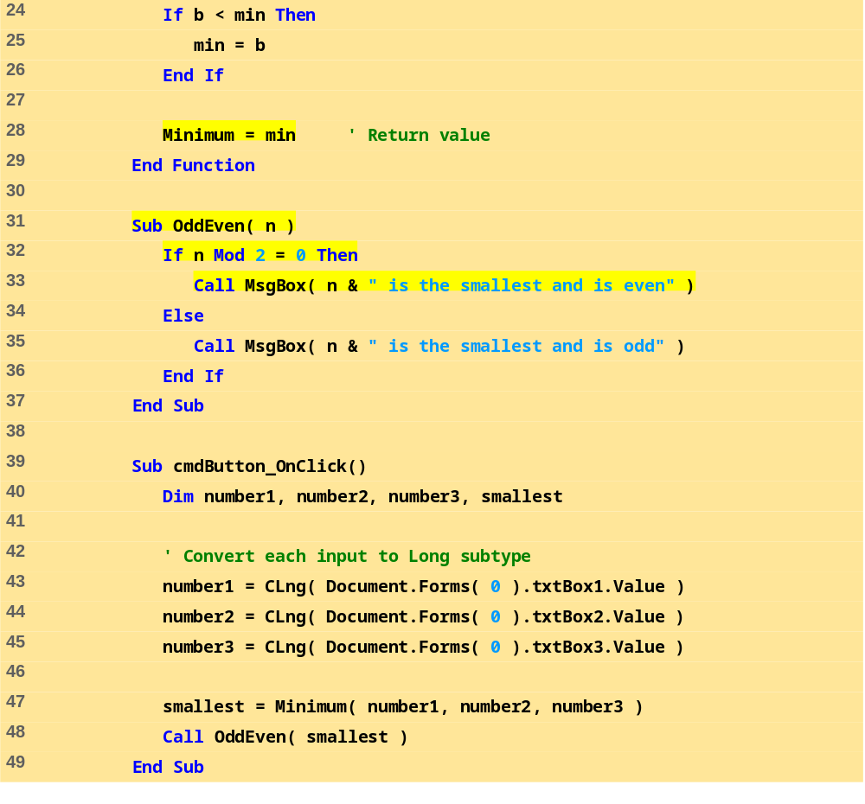
minimum.html
Use modulus operator to determine whether number odd or even.
Single-line comment.
Define an event procedure for handling cmdButton’s OnClick event.
Pass the smallest number to procedure OddEven.
Call function Minimum.

Slide 39
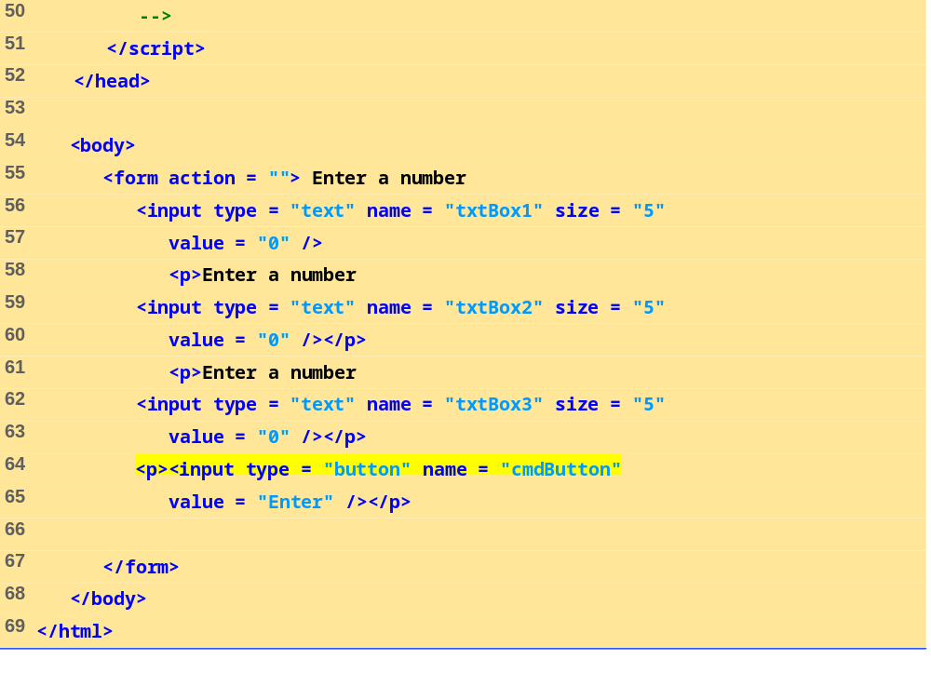
minimum.html

Slide 40
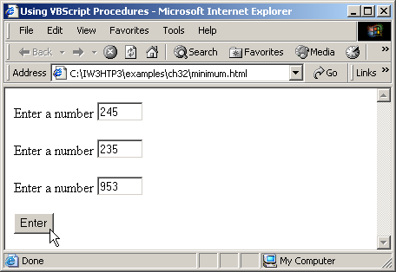
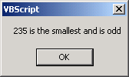
32.5 VBScript Example Programs
Fig. 32.17 Program that determines the smallest of three numbers.

Slide 41
Arrays
Arrays
  Related data items of same type
  Fixed size or dynamic
    Also “redimmable”
  Made up of individual elements
    Accessed via array name, parentheses and index number
    Start at position zero
Declaring arrays
  Keyword Dim
  Name
  Highest valid index
    Upper bound

Slide 42
Arrays
Examples
  Declaring array with three elements
  Dim numbers( 2 )
  Assigning values to each element
  numbers(0) = 77
  numbers(1) = 68
  numbers(2) = 55

Slide 43
32.6 Arrays
Examples, cont.
  Declaring array and using For loop to fill with values
    Fills with multiples of 3 from 0 through 30
  Dim h( 11 ), x, i
  i = 0
  For x = 0 To 30 Step 3
  h(i) = CInt( x )
  i = CInt( i ) + 1
  Next

Slide 44
32.6 Arrays
Array dimensions
  UBound and LBound functions
    LBound is always zero
Access modifiers
  Public vs. Private
    Public default
Dynamic arrays
  Keyword ReDim
    Keyword Preserve
    Allocating arrays larger than original vs. smaller than original
  Keyword Erase

Slide 45
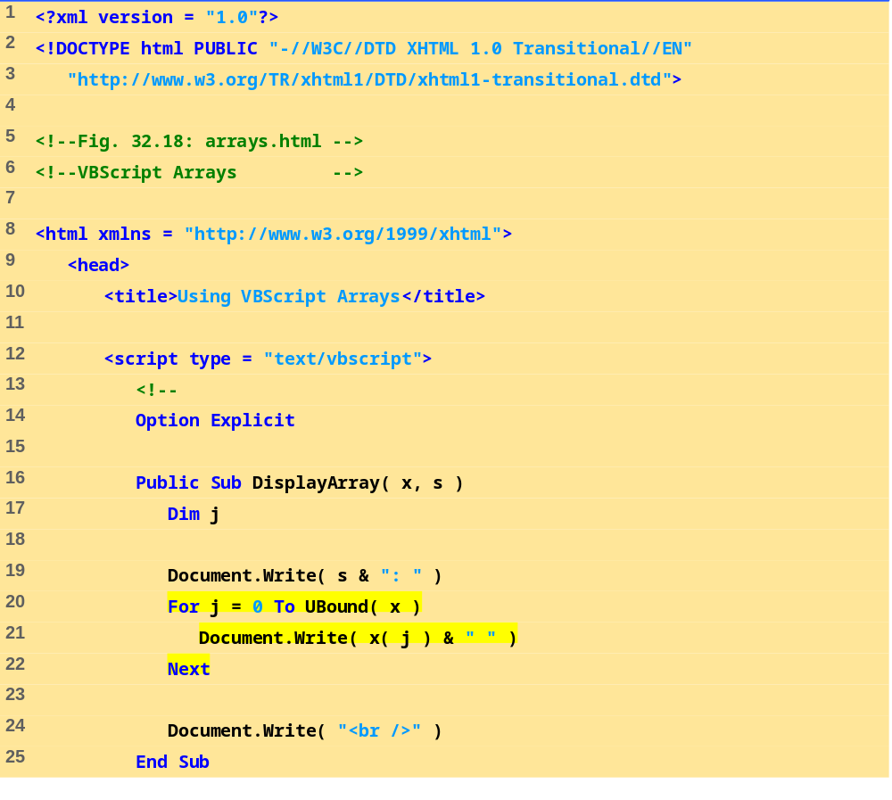
arrays.html
Define procedure DisplayArray.
Function UBound returns the upper bound (i.e., the highest-numbered index).

Slide 46
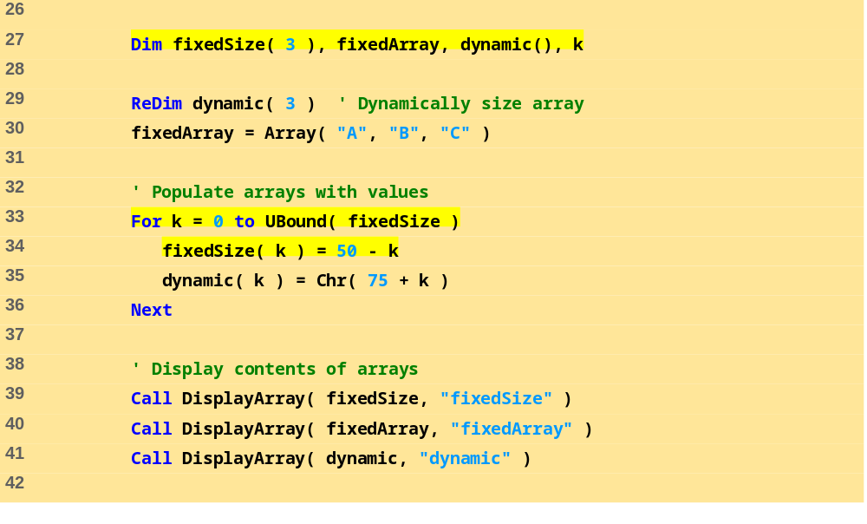
arrays.html
Initialize arrays.
Function Array takes any number of arguments and returns an array containing those arguments.
Statement ReDim allocates memory for array dynamic.

Slide 47
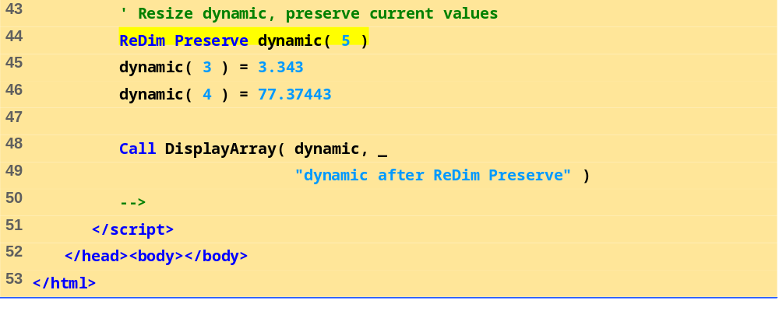
arrays.html
Reallocate dynamic’s memory to 5 elements. Keyword Preserve, when used with ReDim, maintains the current values in the array.
Call procedure DisplayArray.

Slide 48
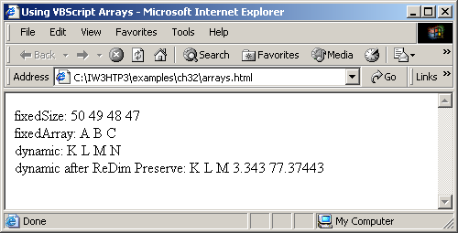
32.5 VBScript Example Programs
Fig. 32.18 Using VBScript arrays.

Slide 49
32.6 Arrays
Multidimensional arrays
  Like normal arrays
    Rows and columns rather than just columns
  UBound and LBound still work
    Dimension is second argument
  Can be fixed size or created dynamically

Slide 50
32.6 Arrays
Examples of multidimensional arrays
  Declaring two- and three-dimensional arrays
  Dim b(2, 2), tripleArray(100, 8, 15)
  Determining upper bound of third dimension
  For x = 0 To UBound(tripleArray, 3)
  Dynamically allocating three-dimensional array
  ReDim threeD(11, 8, 1)

Slide 51
32.7 String Manipulation
Strings
  Case sensitive in VBScript
  Most string manipulation functions do not modify original
    Return new string with modifications

Slide 52
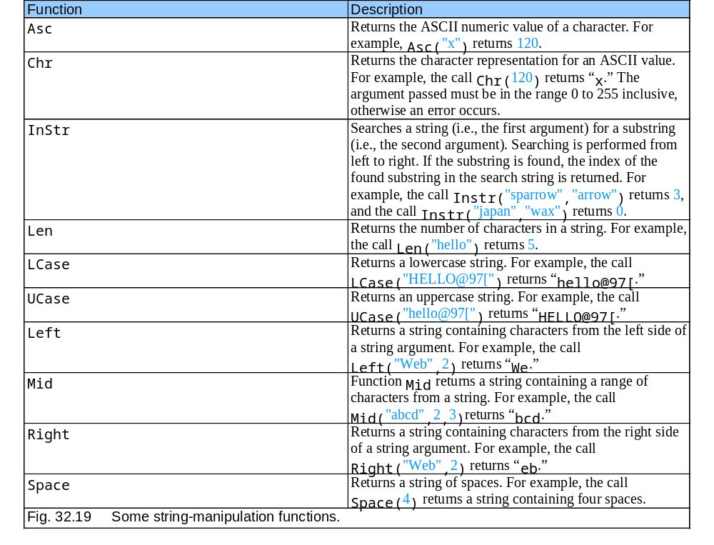
32.7 String Manipulation

Slide 53
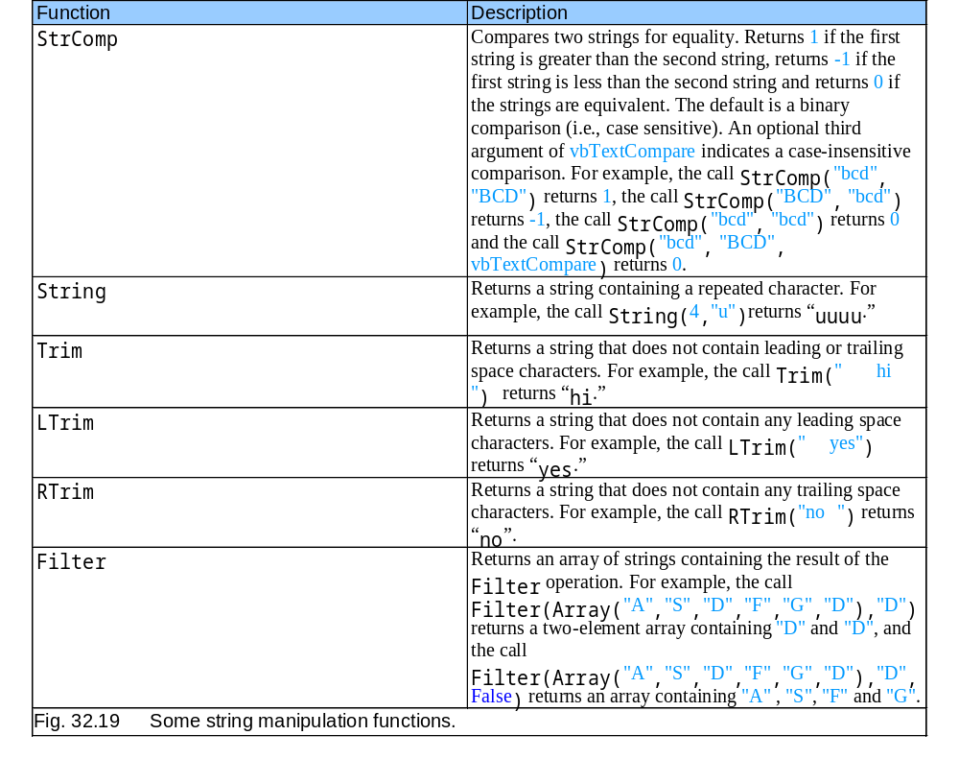
32.7 String Manipulation

Slide 54
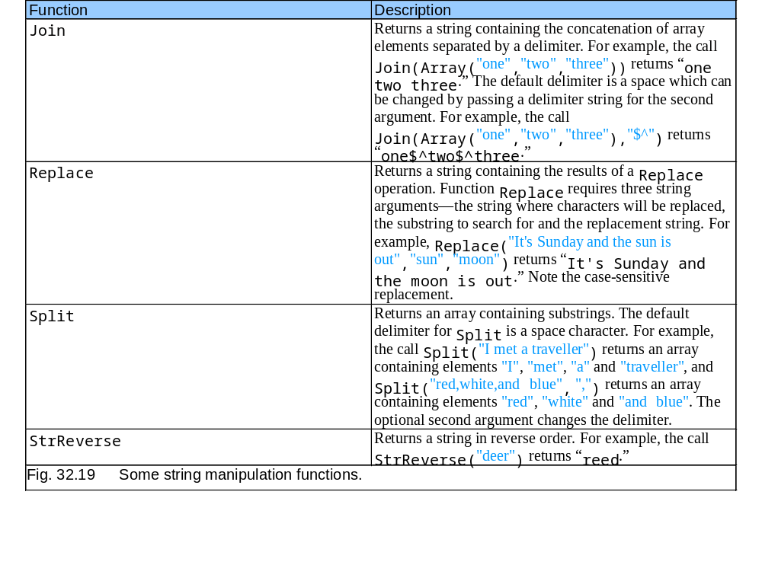
32.7 String Manipulation

Slide 55
32.7 String Manipulation
Translating to Pig Latin
  Uses string methods
    Split
    InStr
    LCase
    Left

Slide 56
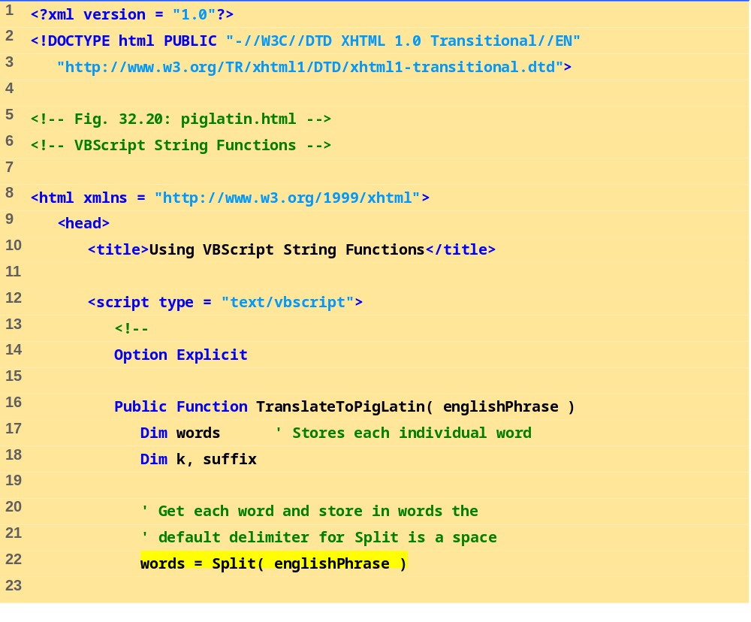
piglatin.html
(1 of 3)
Define Function procedure TranslateToPigLatin
Split phrase into words

Slide 57
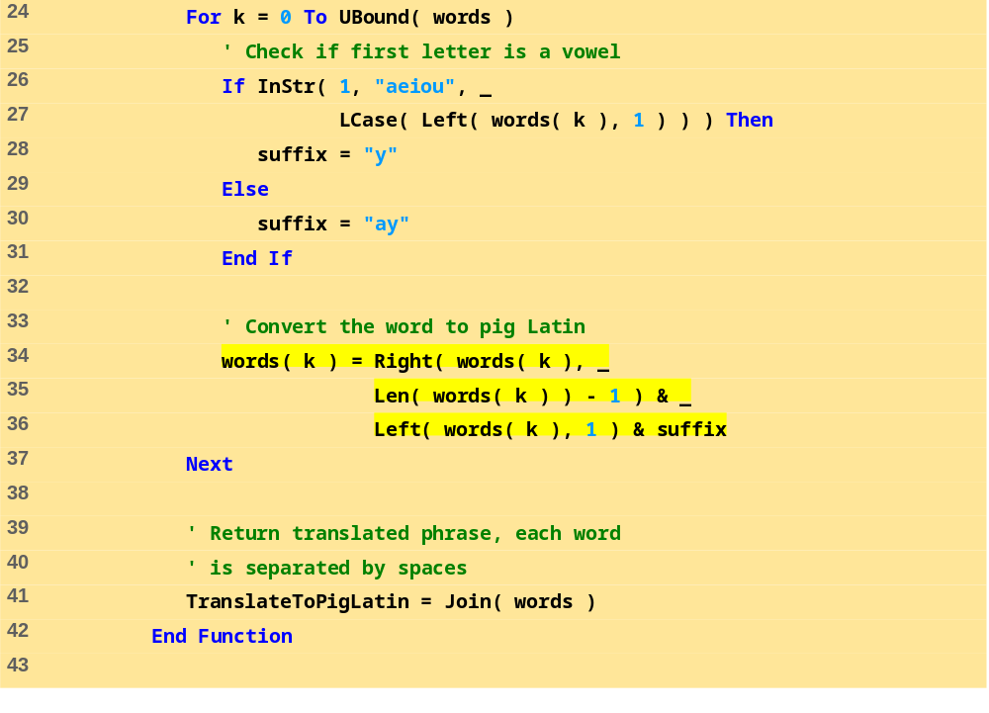
piglatin.html
(2 of 3)
Convert each word to pig Latin
Function LCase returns a lowercase string.
Function InStr searches a string for a substring.
Function Left returns a string containing characters from the left side of a string argument.
Function Right returns a string containing characters from the right side of a string argument.
Function Len returns the number of characters in a string.
Return translated phrase using Join function

Slide 58
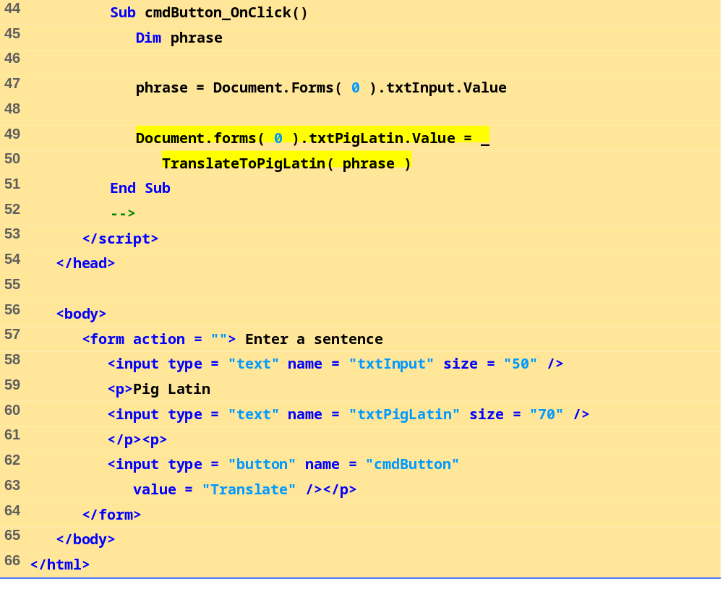
piglatin.html
(3 of 3)
Define an event procedure for cmdButton’s OnClick event.

Slide 59
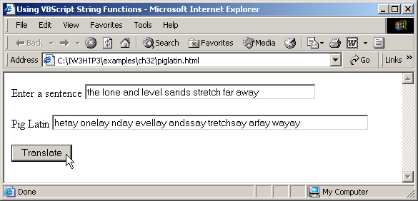
32.7 String Manipulation
Fig. 32.20 Using VBScript string-processing functions.

Slide 60
32.8 Classes and Objects
Object-based programming
  Objects have data and behavior
  Information hiding
    Not necessary to know internal details to use class
    Allows class internals to be replaced/upgraded without breaking code that uses class
  Objects model real-world entities
    Makes programs easier to understand
  Promotes reusability
  Objects are instances of classes
    Class can have many objects existing at same time

Slide 61
32.8 Classes and Objects
Objects in VBScript
  Keyword Class
  Methods
    Procedures that belong to class
  Instance variables
    Exist only inside class

Slide 62
32.8 Classes and Objects
Abstract data-types
  Powerful feature for simplifying programs
  Represented as classes
  Describe data in terms of behavior
  Instance variables should be Private
    Allow access through methods
    Ensure integrity and consistency
    Property Let, Property Get, Property Set
    Exit Property

Slide 63
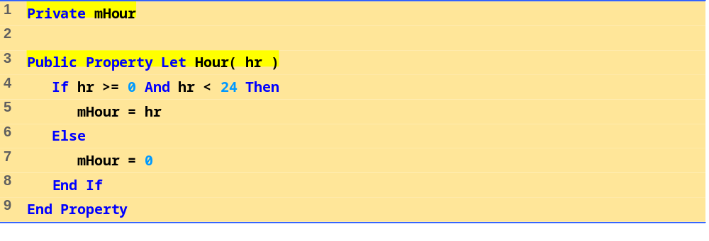
Property Let Sample
(1 of 1)
A simple Property Let procedure

Slide 64
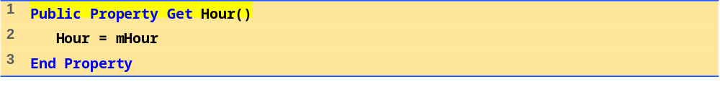
Property Let Sample
(1 of 1)
A simple Property Get procedure

Slide 65
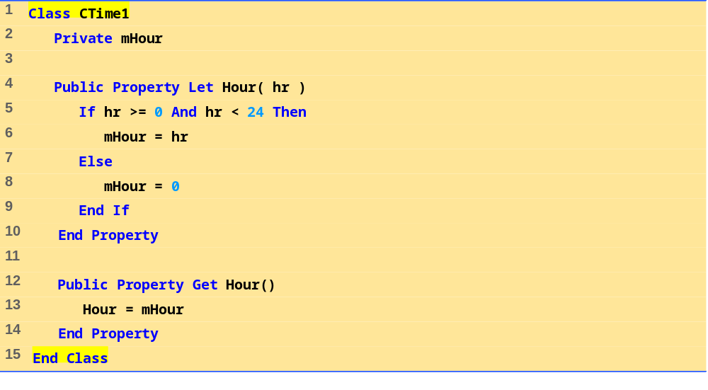
Class Definition Sample
(1 of 1)
A simple Class definition

Slide 66
32.8 Classes and Objects
Property Set
  Use for basic Variant sub-type variables
  Public Property Set BirthDay(bDay)
  Set mBirthDate = bDay
  End Property
  Public Property Get BirthDay()
  Set BirthDay = mBirthDate
  End Property

Slide 67
32.8 Classes and Objects
Regular expressions in VBScript
  Pattern matching
  Class RegExp
    Pattern property
    Test method
  ^ character
    Beginning of string
  \d
    Digits
  { }
    Exactly this many occurrences

Slide 68
32.8 Classes and Objects
Regular expressions in VBScript, cont.
  $ character
    End of string
  Literal characters
Simplifying properties
  Keywords With…End With
    Reduces amount of typing

Slide 69
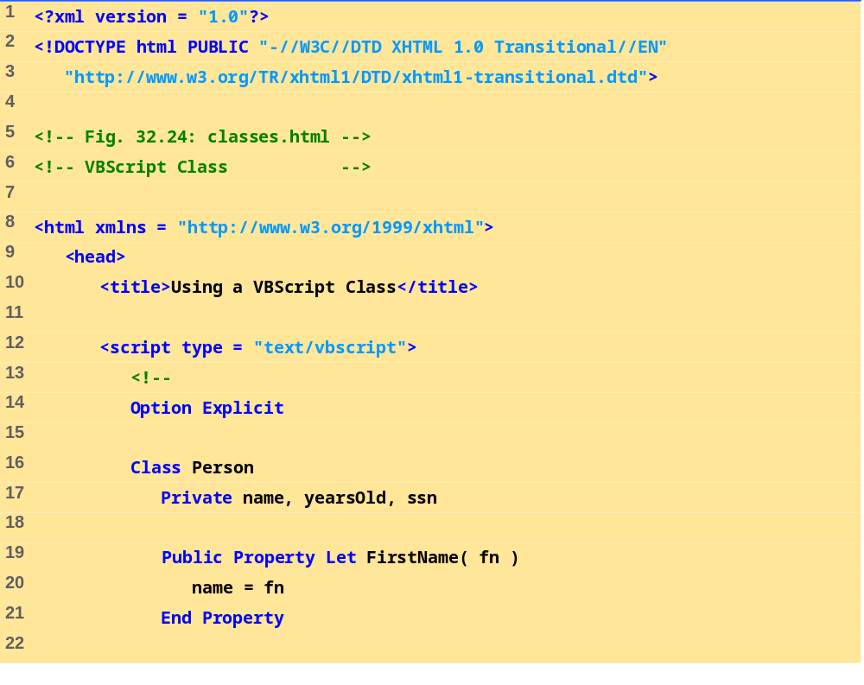
classes.html
(1 of 5)
Define Class Person
Define Property Let and Property Get procedures

Slide 70
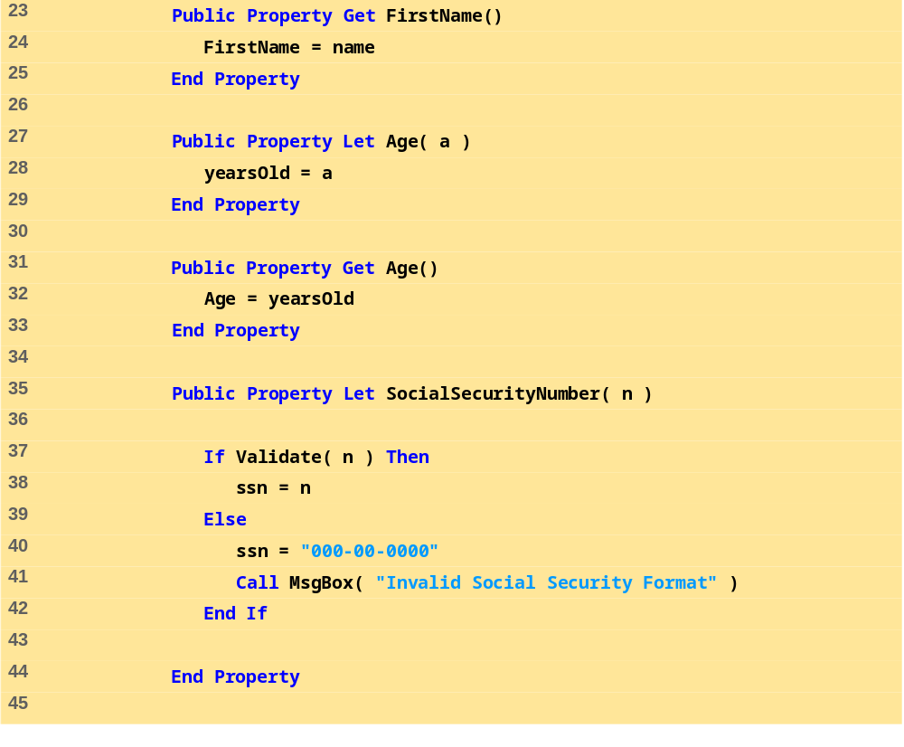
classes.html
(2 of 5)
Define Property Let SocialSecurityNumber
Call function Validate

Slide 71
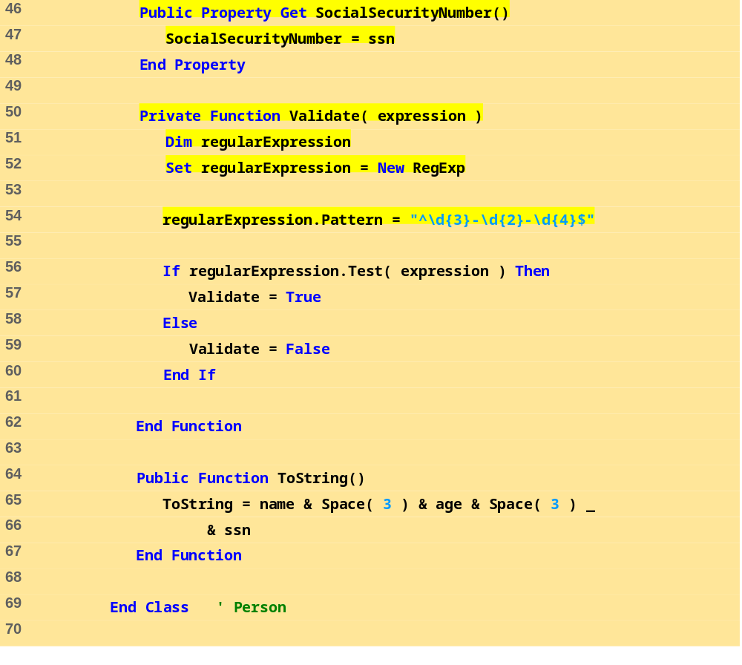
classes.html
(3 of 5)
Define Function Validate
Use regular expression to check format
Define Function ToString.

Slide 72
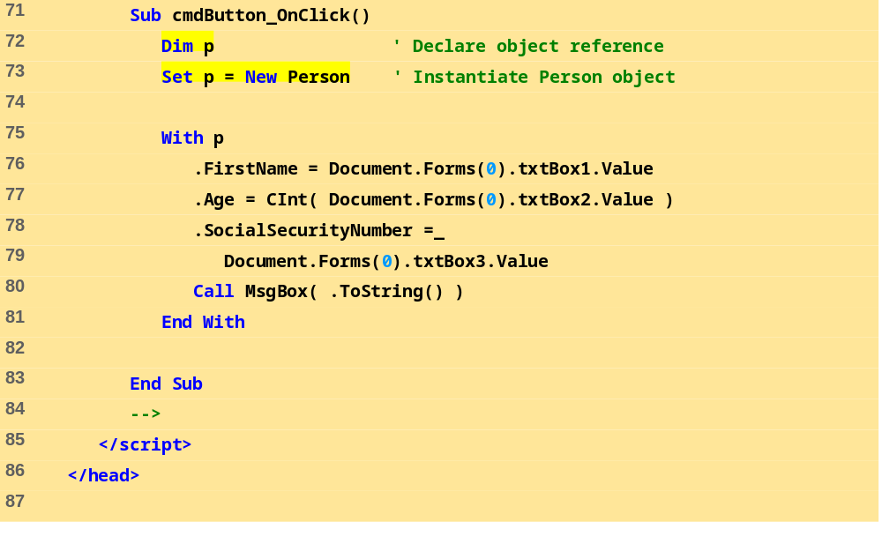
classes.html
(4 of 5)
Provide an event procedure for cmdButton’s OnClick event.
Instantiate Person object.
Use the With…End With statement to set several property values for p and call p’s ToString method.

Slide 73
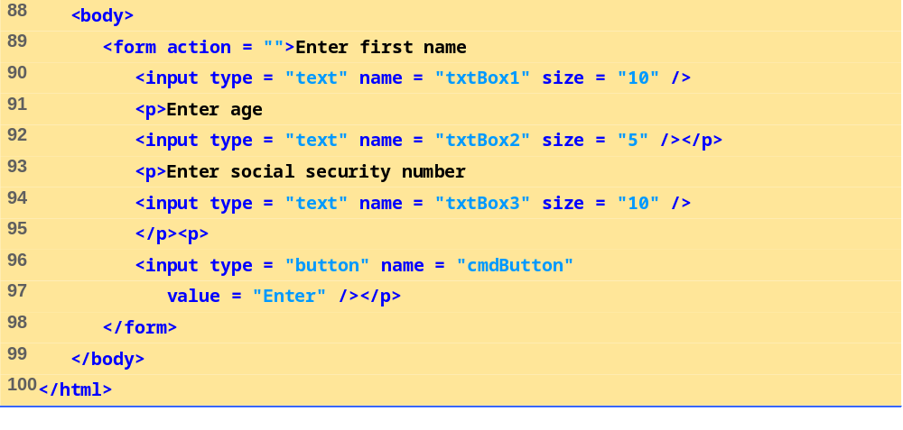
classes.html
(5 of 5)

Slide 74
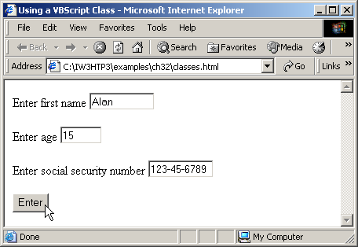
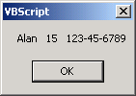
32.8 Classes and Objects
Fig. 32.24 Using VBScript classes and regular expressions.

Slide 75



32.8 Classes and Objects
Fig. 32.24 Using VBScript classes and regular expressions.

Slide 76

32.9 Operator Precedence Chart

